Slide 1
CAR ALERTS - ANGULAR PROJECT
Nikolay stanchev, Information systems, f.n 71830, fmi sofia university

Slide 2
Description
The project allows for users to view driving-related alerts on a map such as:
Speed camers
Car accidents
Toll
Traffic jams
Registered Users can add new alerts and edit and/or delete their owns. Admins can delete and edit everyone. Users that are not logged can only browse the map

Slide 3
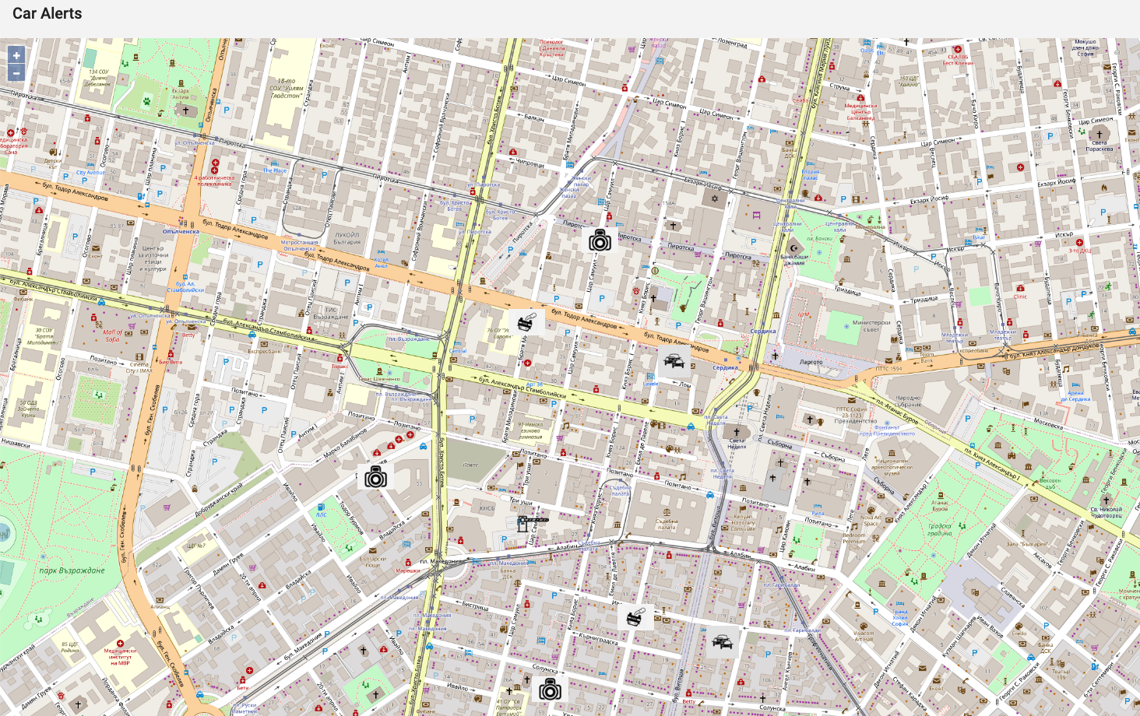
THE MAP

Slide 4
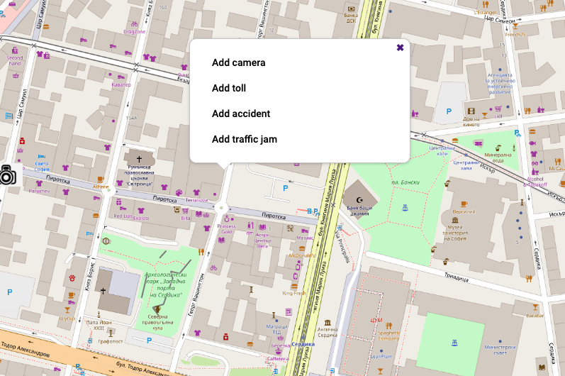
THE MAP – ADDING ALERT
Via show/hide modal box

Slide 5
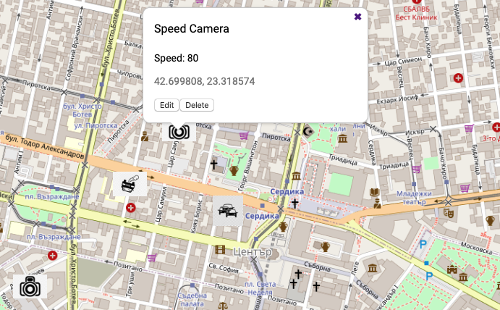
MAP – EDITING aLERT
Edit box is a dynamically loaded component

Slide 6
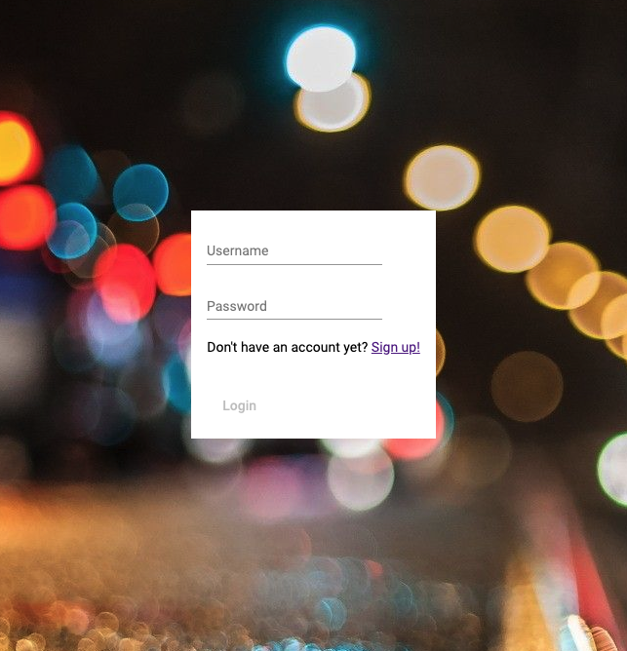
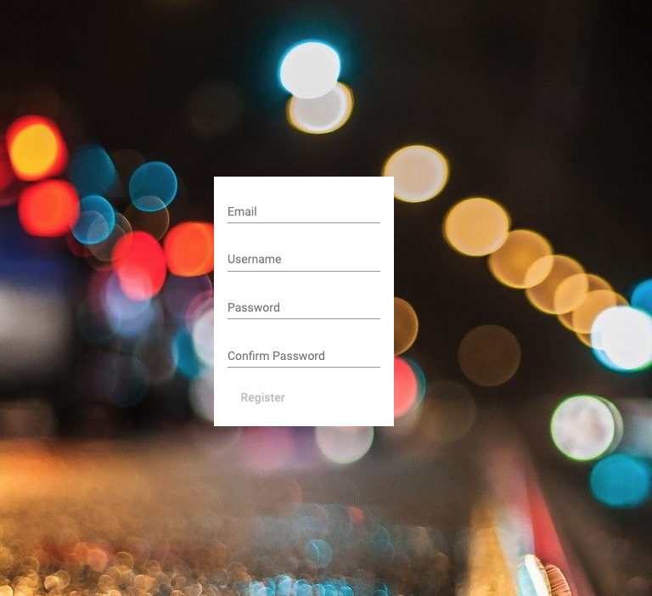
Authentication
Authentication is done via JWT tokens
Angular validation and show/hide of buttons + backend middleware validation

Slide 7
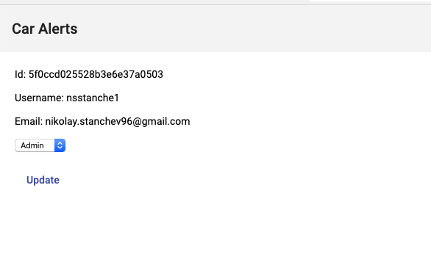
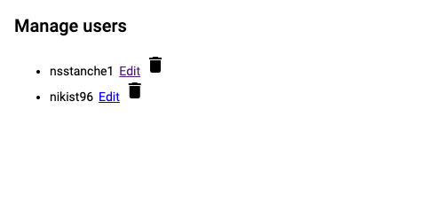
Admin – MANAGInG uSers
Admins can delete users or change their roles.

Slide 8
Thank you for the attention! Questions?

